Slide 1
Temperature affection on water
By: Pa Yeng Yang

Slide 2
INTRODUCTION
QUESTION: CAN THE WEATHER AFFECT YOUR PRODUCTIVITY
NULL HYPOTHESIS: There is no relationship between weather and productivity
ALTERNATIVE HYPOTHESIS: There is relationship between weather and productivity
RESEARCH STATE: “Sunny weather increases productivity”
DATA PROCESS:
Collect temperature per day as for weather variables
Collect the number steps I take per day as for the Productivity variables

Slide 3
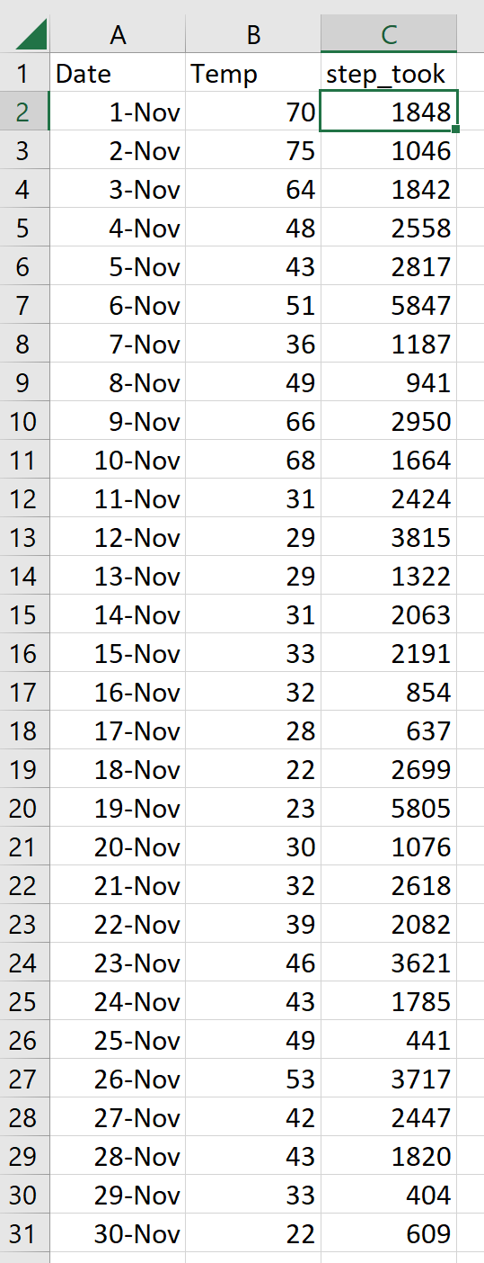
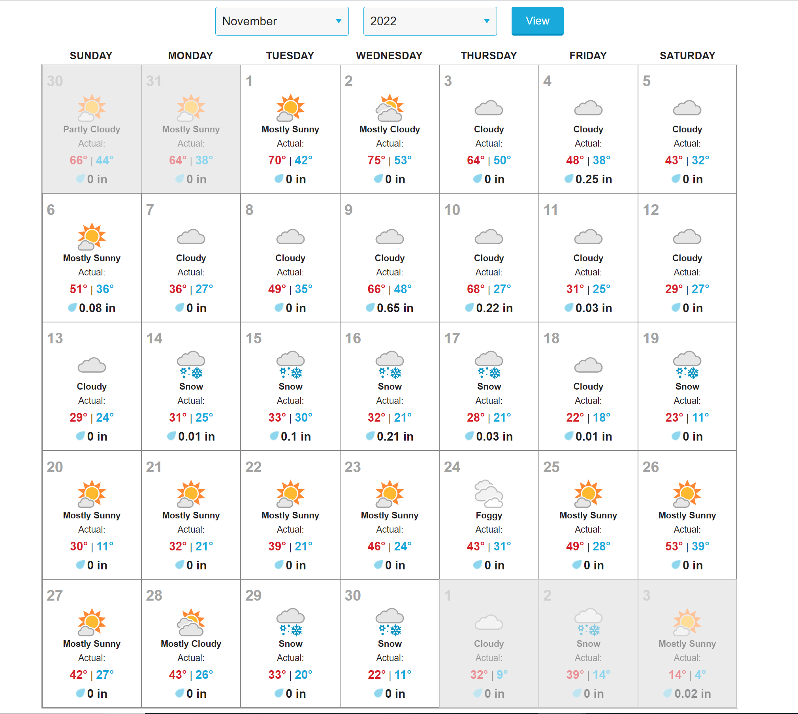
DATA:

Slide 4
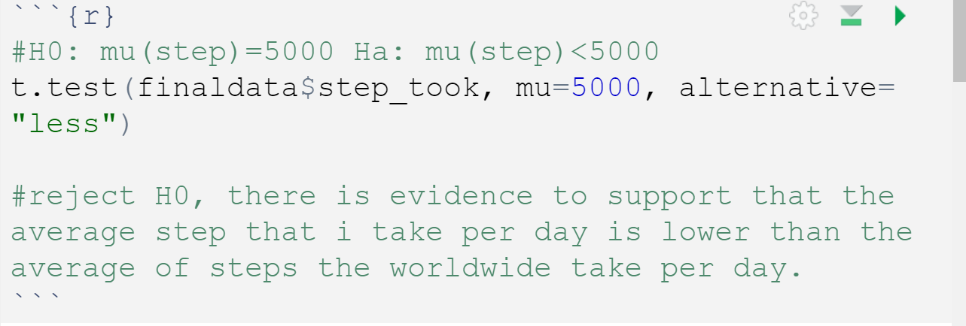
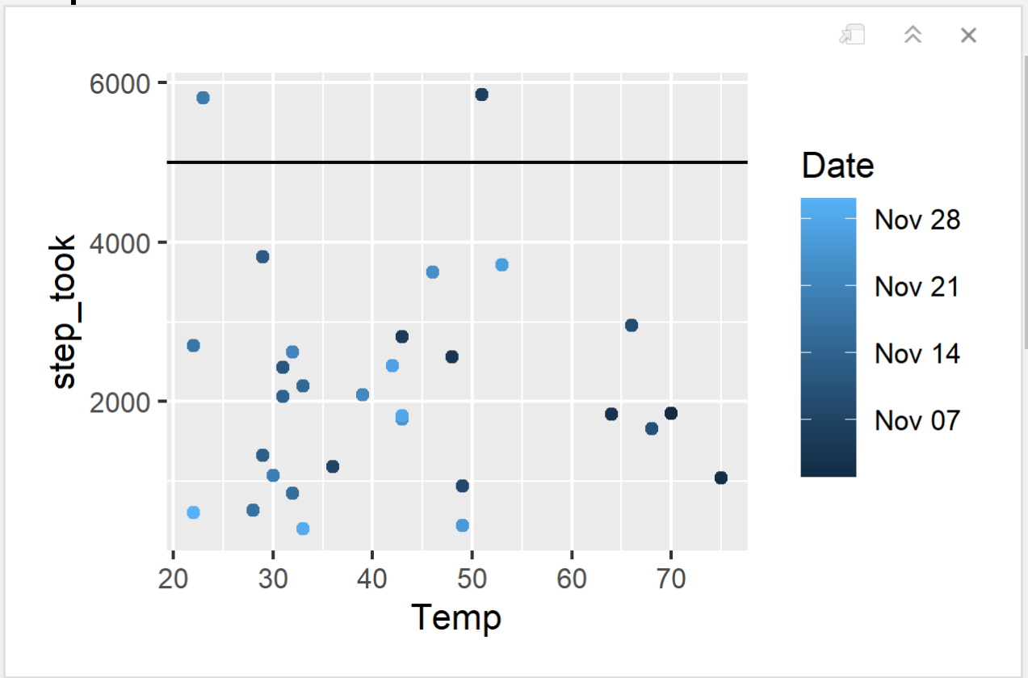
IS MY STEP AVERAGE?

Slide 5
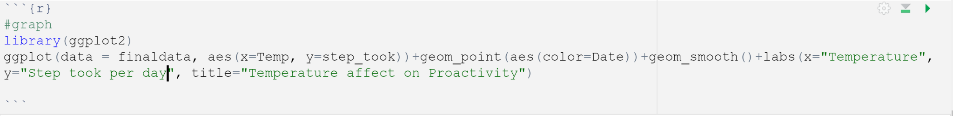
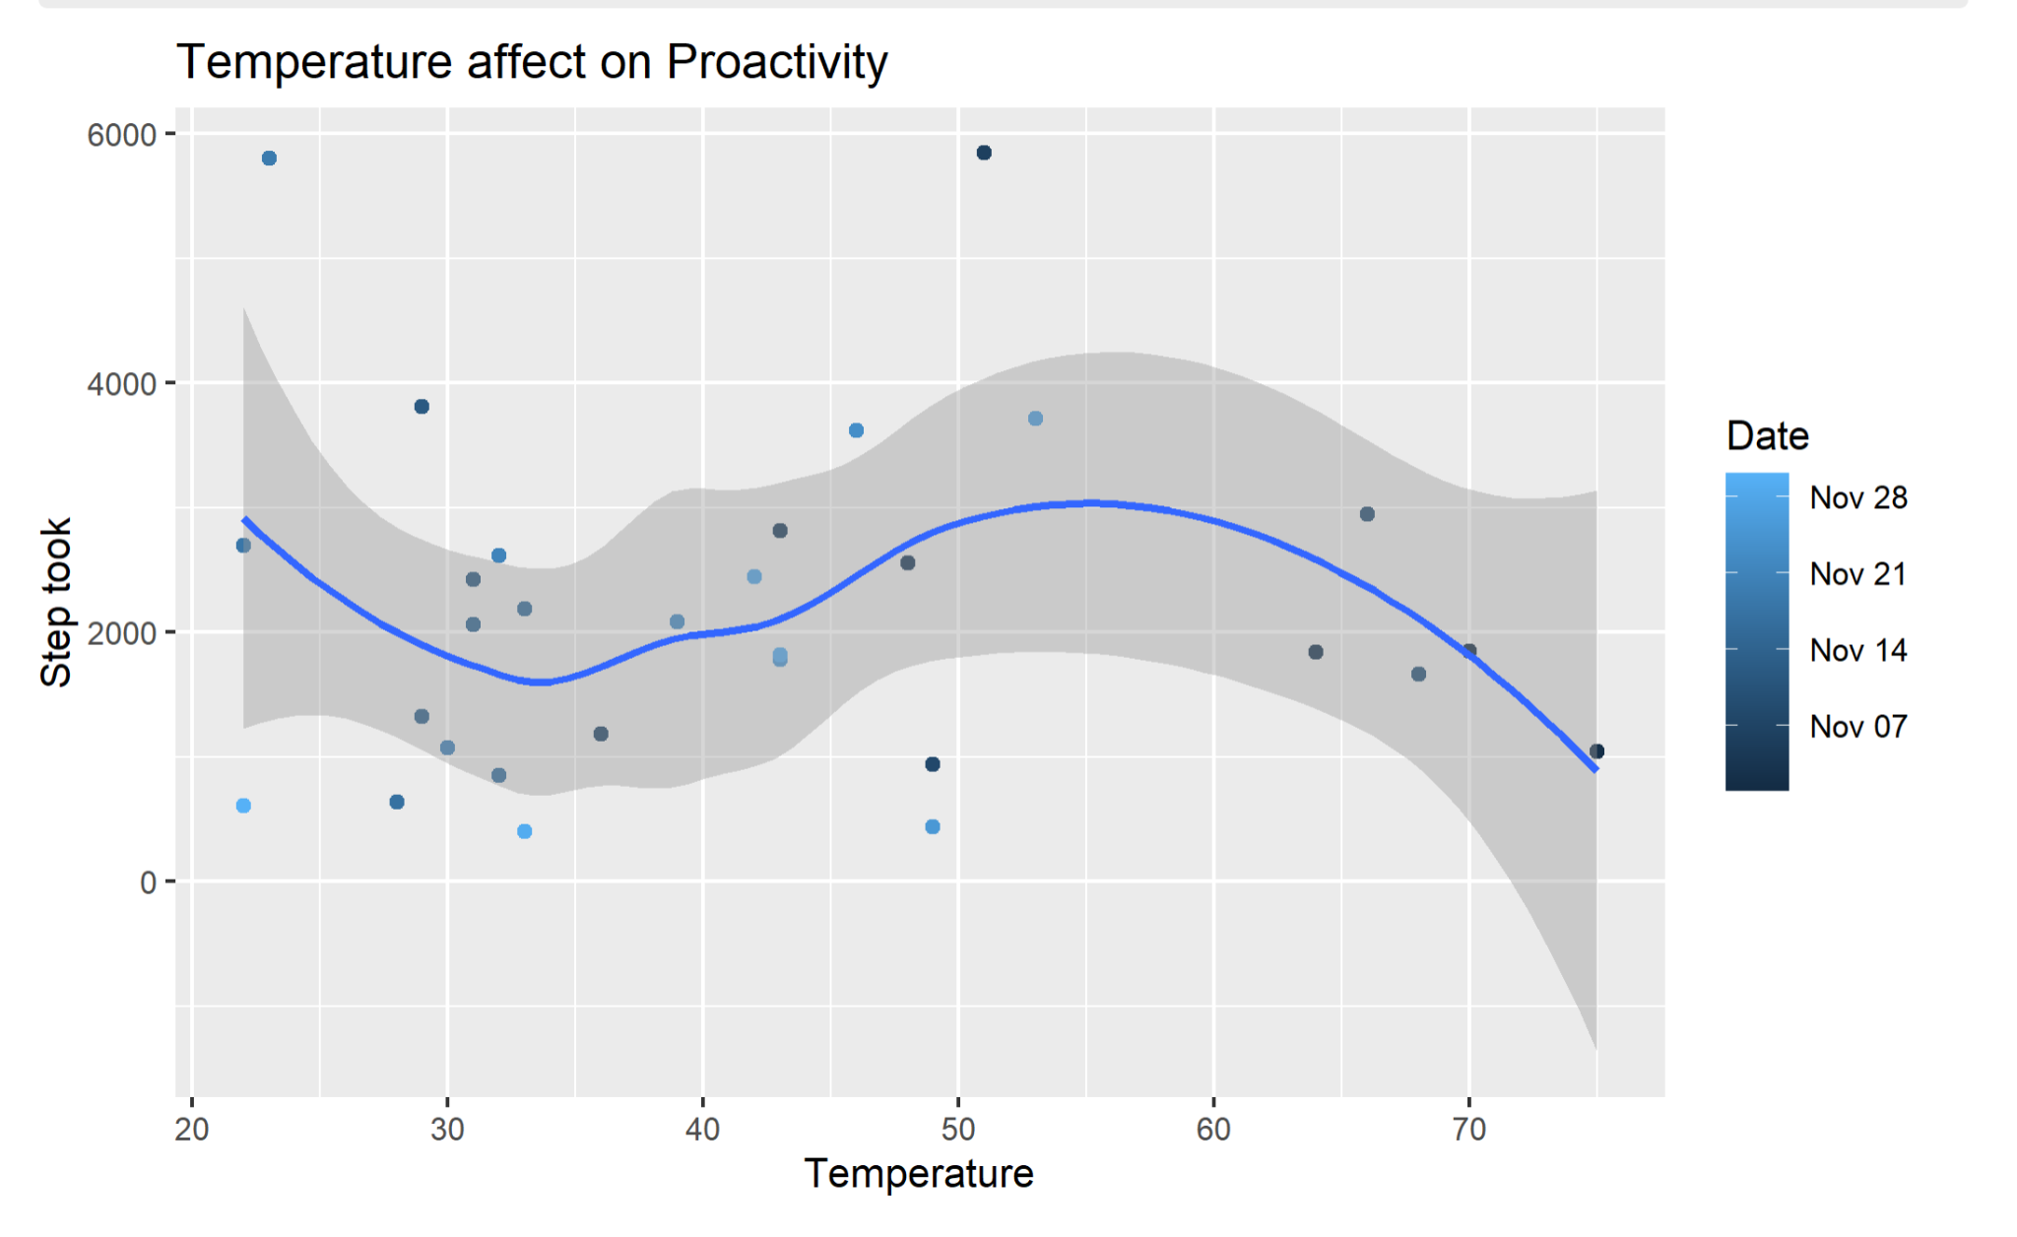
GRAPHING

Slide 6
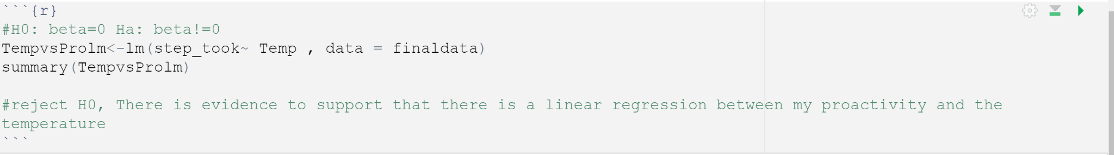
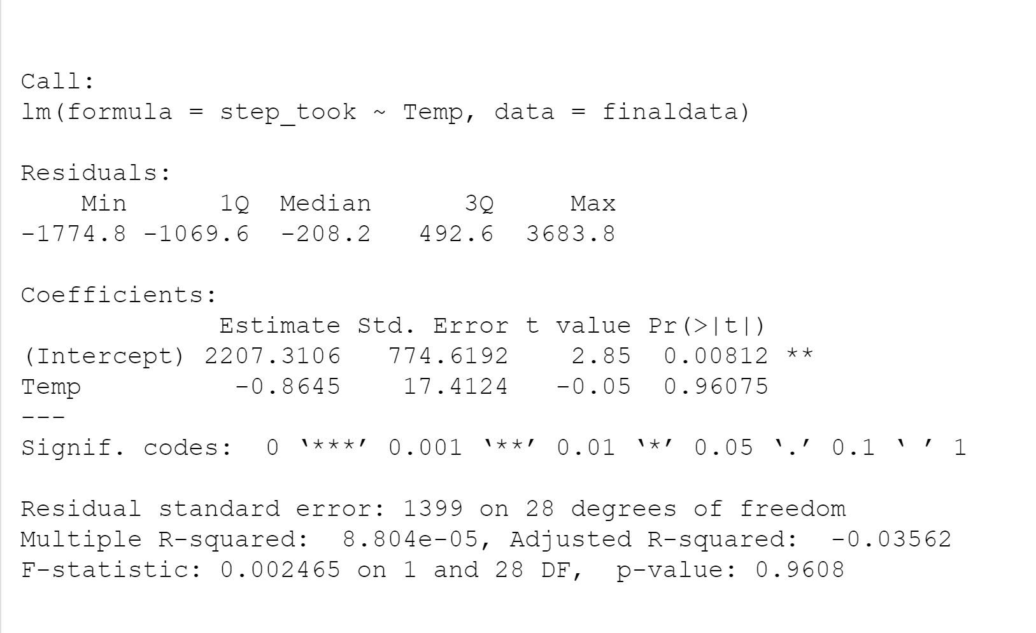
REGRESSION

